Slide 1
COMP 691: Online Algorithms and Competitive Analysis
Week 1
Denis Pankratov

Slide 2
Introduction

Slide 3
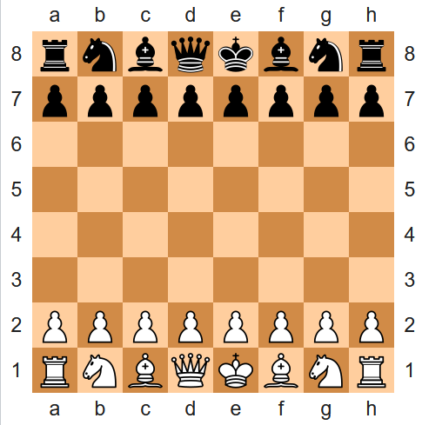
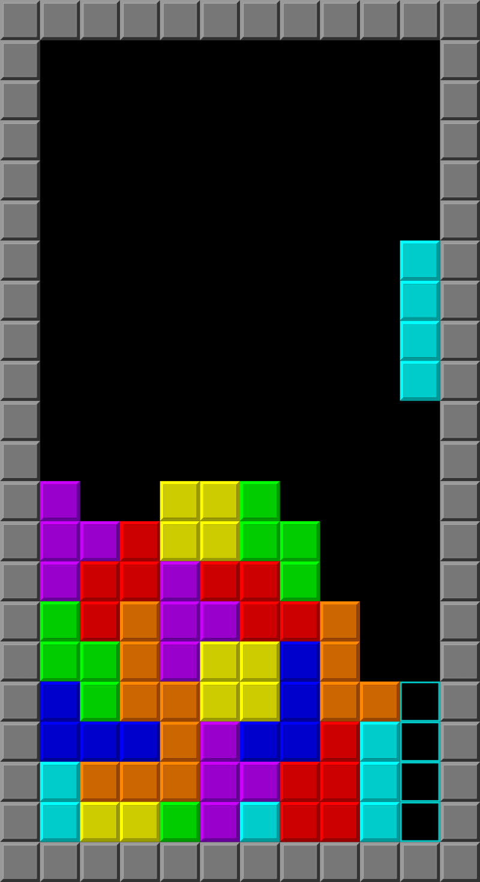
Chess vs Tetris

Slide 4
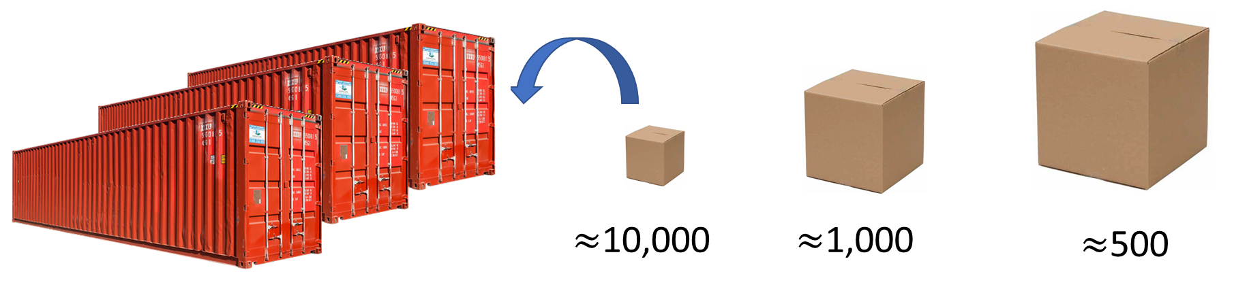


Real Life Examples
Packing
Online Advertising
Taxicab dispatch

Slide 5


Online Algorithms: Main Features
Lack of information about future inputs
Irrevocable decisions

Slide 6
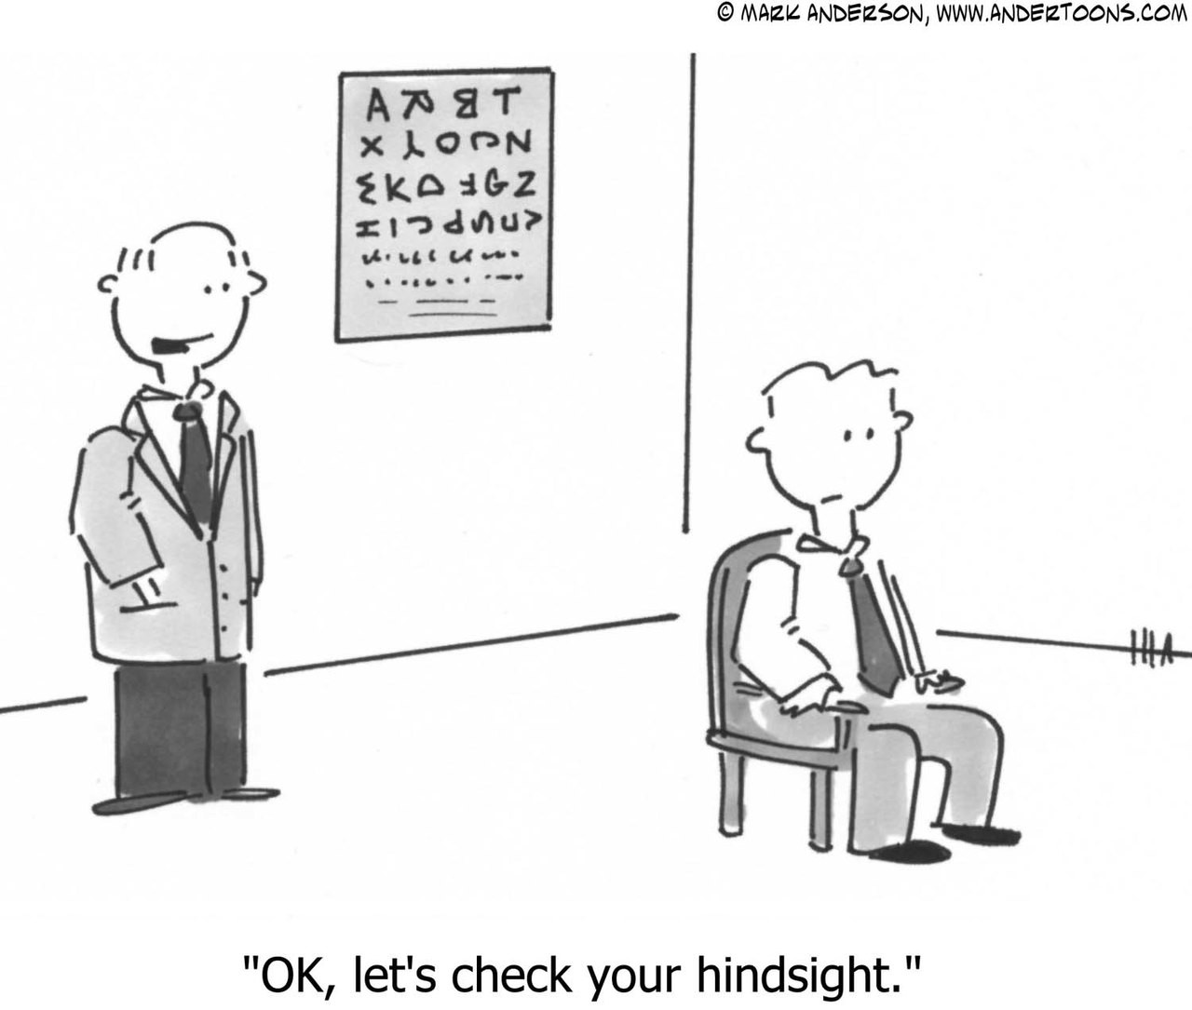
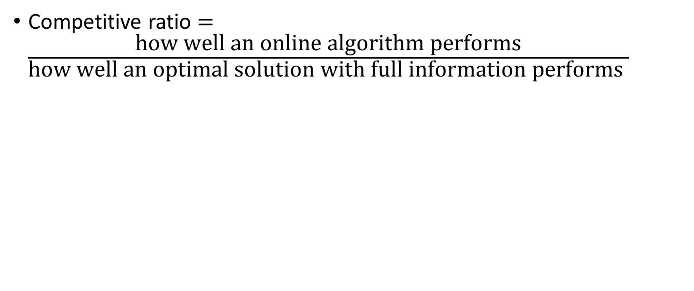
How to Measure Performance
Competitive ratio $=\frac{\text{how} \text{well} \text{an} \text{online} \text{algorithm} \text{performs}}{\text{how} \text{well} \text{an} \text{optimal} \text{solution} \text{with} \text{full} \text{information} \text{performs} }$
Notes:
在线算法的表现/具有完全信息的最优解的表现
Optimal 最佳的

Slide 7

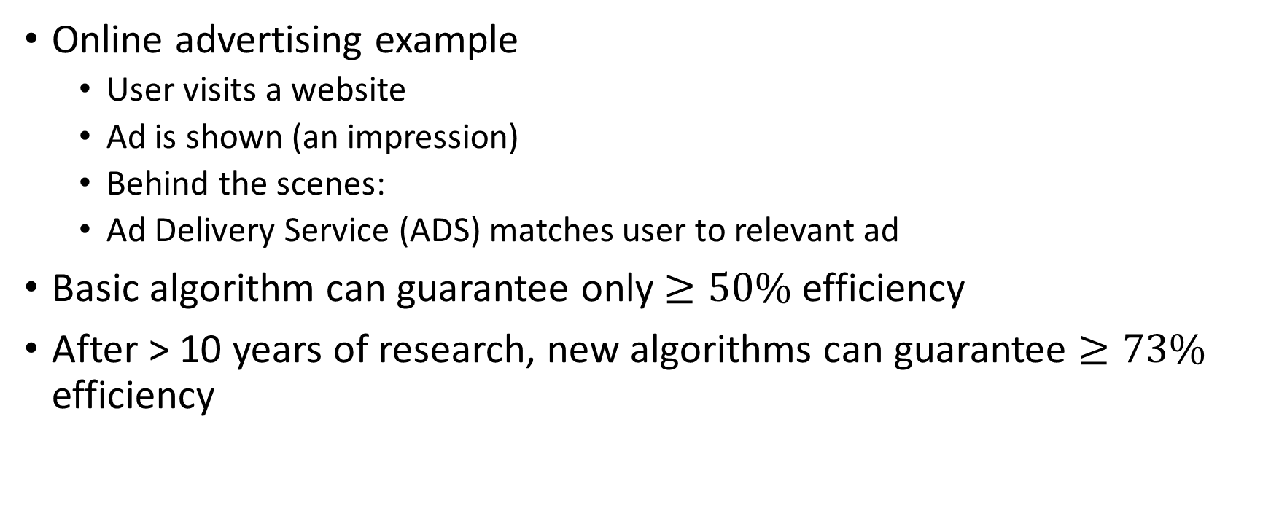
Theoretical Analysis is Important
Online advertising example
User visits a website
Ad is shown (an impression)
Behind the scenes:
Ad Delivery Service (ADS) matches user to relevant ad
Basic algorithm can guarantee only $≥50\%$ efficiency
After > 10 years of research, new algorithms can guarantee $≥73\%$ efficiency

Slide 8
Take Away Points
Online algorithms are important, and they are behind many large-scale systems affecting our everyday life
Theoretical analysis and design techniques of online algorithms are active areas of research
Relatively new area of research (first book on the subject was published in 1998)
Young people with new bold ideas, like yourself, are needed to push the area forward

Slide 9
Offline problems
Given input, examine it in its entirety, and produce some output
Examples:
given a graph, find a minimum spanning tree
given a course calendar, schedule exams with no conflicts
given a Boolean formula, find a satisfying assignment
given a flow network, find a maximum flow
etc…
Notes:
Entirety全部内容

Slide 10
Online problems
Require decisions to be done in real time without seeing future input
Examples:
patients arrive at a clinic, assign them to be seen by doctors
jobs arrive at a supercomputer, assign them to computing units
packets arrive at a switch port, forward them to an outgoing port
user clicks on a website, decide which ad to display, etc…
In all cases, decisions are either fully or at least partially irrevocable

Slide 11
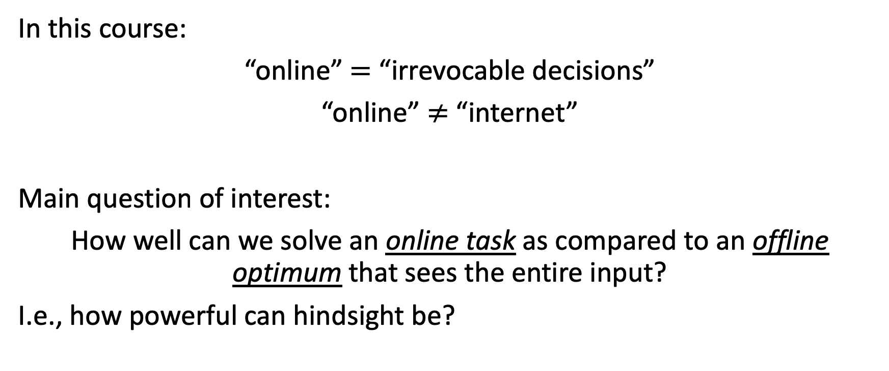
Measure of quality of an online solution
In this course:
“online” $=$ “irrevocable decisions”
“online” $≠$ “internet”
Main question of interest:
How well can we solve an online task as compared to an offline optimum that sees the entire input?
I.e., how powerful can hindsight be?

Slide 12
Offline
Online
Input
Output
Input
Output
Item 1
Decision 1
Item 1
Decision 1
ALG
ALG
Item 2
Decision 2
Item 2
Decision 2
…
…
…
…
Item n
Decision n
Item n
Decision n

Slide 13
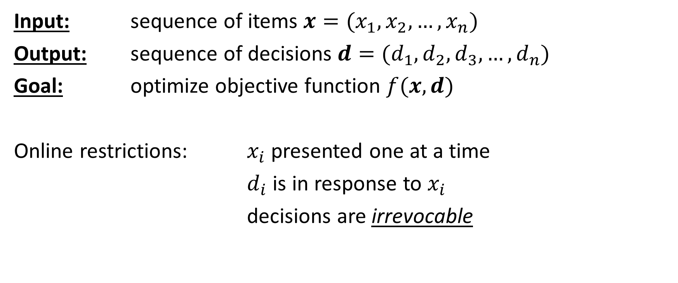
Online problem template
Input: sequence of items $x=(x_{1}, x_{2}, …, x_{n})$
Output: sequence of decisions $d=(d_{1}, d_{2},d_{3}, …, d_{n})$
Goal: optimize objective function $f(x,d)$
Online restrictions: $x_{i}$ presented one at a time
$d_{i}$ is in response to $x_{i}$
decisions are irrevocable
Notes:
目的：优化目标函数
Optimize:优化
Objective: 客观的
逐个输入呈现： 输入项 xi​ 是逐个呈现的，无法提前知道未来输入。
决策依赖当前输入： 决策 di​ 是针对当前输入 xix_ixi​ 做出的，无法依赖未来的信息。
决策不可撤销（Irrevocable）： 一旦决策 di​ 做出，就无法修改或撤销。

Slide 14
Online problem example: Ski Rental
Can rent skis for 10$ or buy skis for 100$
Day
1
2
3
4
5
Weather
Decision
rent
rent
buy
N/A
N/A
Accumulated
Cost
10$
20$
120$
120$
120$

Slide 15
Online problem example: Ski Rental
For this instance (rent 10$, buy 100$)
Online solution: 120$ (how much we paid)
Offline optimal solution: 40$ (we would have rented, if we knew the whole input)
Overpaid by a factor 120/40 = 3
Weather

Slide 16
Online problem example: Ski Rental
Can rent skis for 10$ or buy skis for 30$
Day
1
2
3
4
5
Weather
Decision
rent
rent
buy
N/A
N/A
Accumulated
Cost
10$
20$
50$
50$
50$

Slide 17
Online problem example: Ski Rental
For the new instance (rent 10$, buy 30$)
Online solution: 50$ (how much we paid)
Offline optimal solution: 30$ (we would have bought on the first day if we knew the whole input)
Overpaid by a factor 50/30 = 5/3
Weather

Slide 18
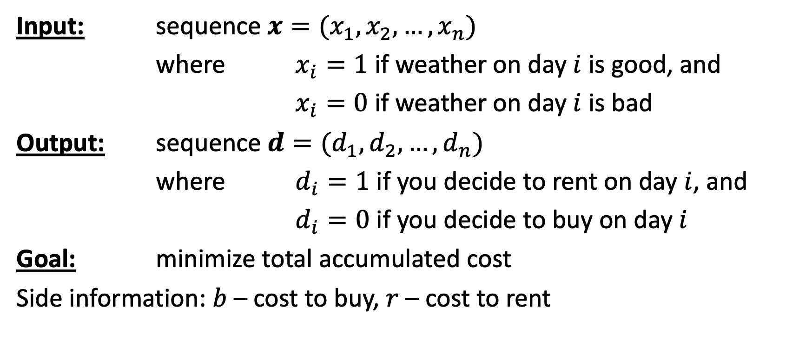
Ski rental formally
Input: sequence $x=(x_{1}, x_{2}, …, x_{n})$
where $x_{i}=1$ if weather on day $i$ is good, and
$x_{i}=0$ if weather on day $i$ is bad
Output: sequence $d=(d_{1}, d_{2}, …, d_{n})$
where $d_{i}=1$ if you decide to rent on day $i$, and
$d_{i}=0$ if you decide to buy on day $i$
Goal: minimize total accumulated cost
Side information: $b$ – cost to buy, $r$ – cost to rent

Slide 19
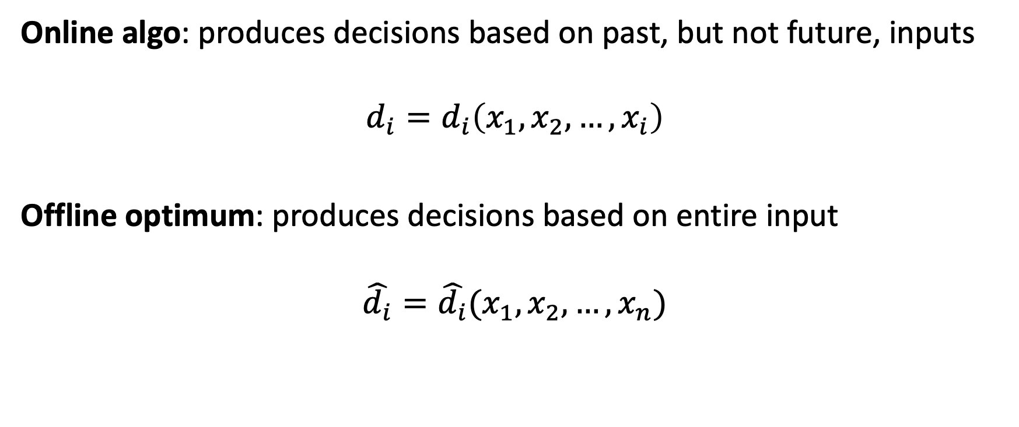
Online algorithm formally
Online algo: produces decisions based on past, but not future, inputs
$$d_{i}=d_{i}\left(x_{1}, x_{2},…, x_{i}\right)$$
Offline optimum: produces decisions based on entire input
$$\hat{d_{i}}=\hat{d_{i}}(x_{1}, x_{2}, …, x_{n})$$

Slide 20
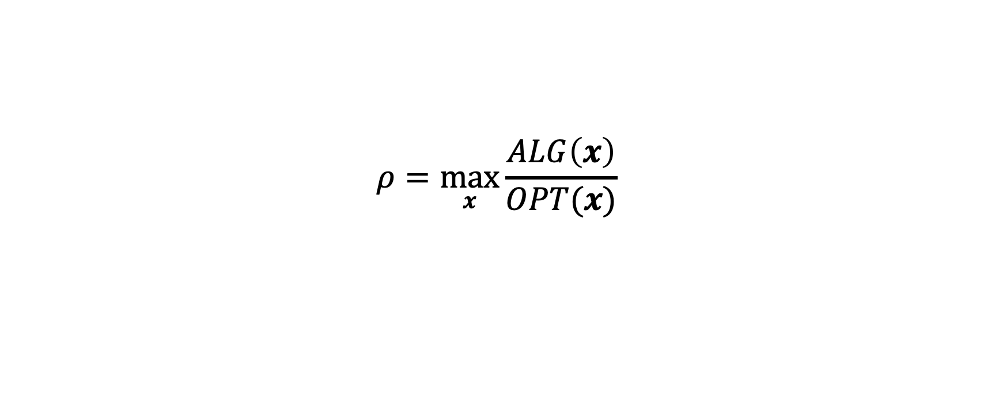
Competitive ratio for minimization problem, informally
$$ρ=\max_{x}{\frac{ALG\left(x\right)}{OPT(x)}}$$
Accumulated cost of our online algorithm
Competitive ratio
”How close can we get to hindsight?”
Accumulated cost of an optimal offline algorithm
Notes:
Hindsight后见之明
Optimal 最佳的
Accumulated 累积的
Algorithm 算法 ˈalɡəˌriT͟Həm
竞争比是基于最坏情况分析的

Slide 21
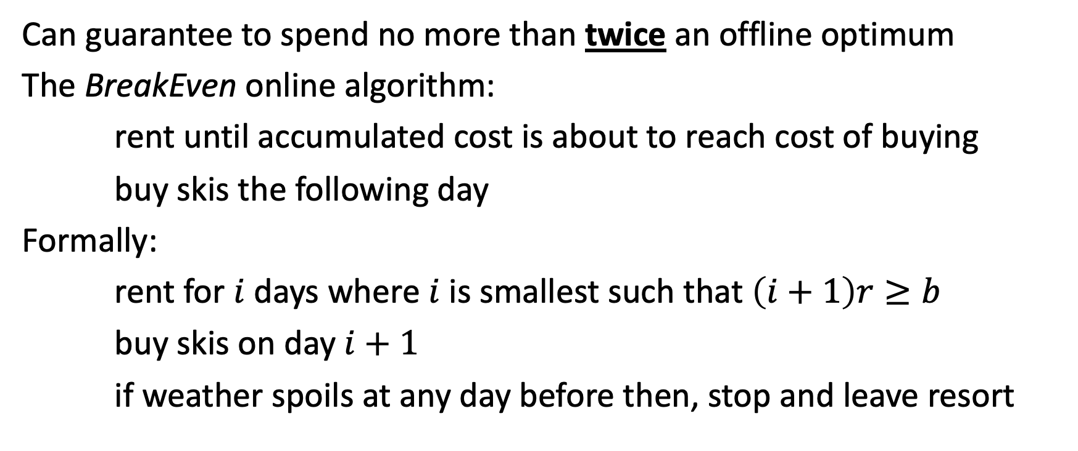
Back to Ski Rental
Can guarantee to spend no more than twice an offline optimum
The BreakEven online algorithm:
rent until accumulated cost is about to reach cost of buying
buy skis the following day
Formally:
rent for $i$ days where $i$ is smallest such that $\left(i+1\right)r≥b$
buy skis on day $i+1$
if weather spoils at any day before then, stop and leave resort

Slide 22
BreakEven algorithm: example
Can rent skis for 10$ or buy skis for 30$
Day
1
2
3
4
5
Weather
Decision
rent
rent
buy
N/A
N/A
Accumulated
Cost
10$
20$
50$
50$
50$

Slide 23
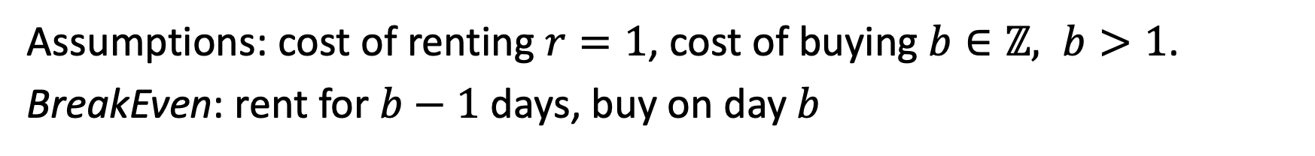
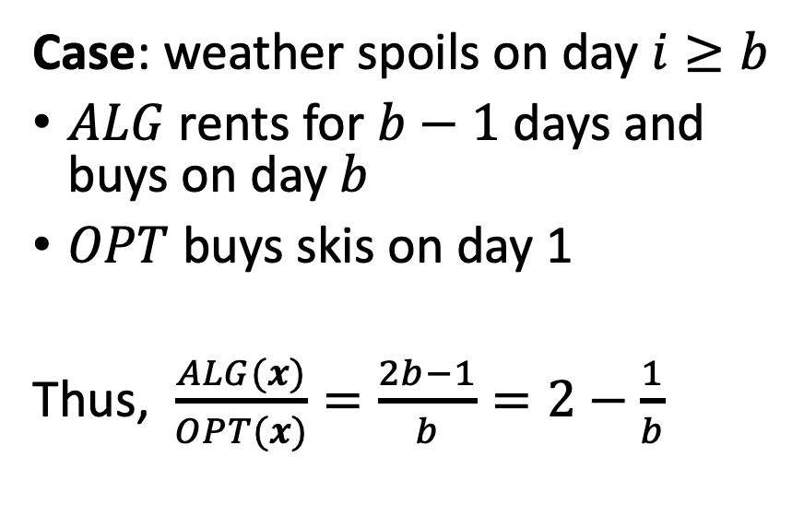
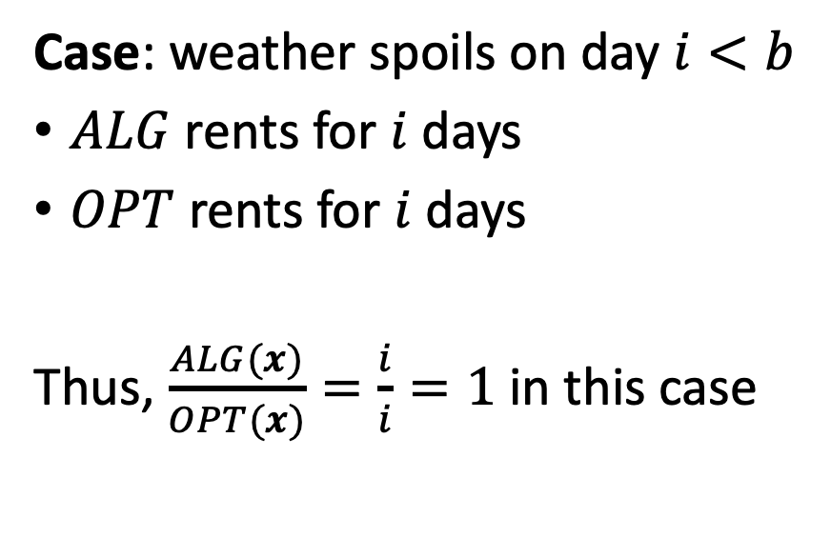
Analysis of BreakEven algorithm
Assumptions: cost of renting $r=1$, cost of buying $b∈ℤ, b>1$.
BreakEven: rent for $b−1$ days, buy on day $b$
Case: weather spoils on day $i<b$
$ALG$ rents for $i$ days
$OPT$ rents for $i$ days
Thus, $\frac{ALG(x)}{OPT(x)}=\frac{i}{i}=1$ in this case
Case: weather spoils on day $i≥b$
$ALG$ rents for $b−1$ days and buys on day $b$
$OPT$ buys skis on day 1
Thus, $\frac{ALG(x)}{OPT(x)}=\frac{2b−1}{b}=2−\frac{1}{b}$
Overall, $ρ=\text{max} \left(1, 2−\frac{1}{b}\right)=2−\frac{1}{b}→2$ as $b→∞$
Notes:
我们为什么要假设每天借用的费用是1，只是为了便于计算？
为了得到 2 – 1/b,从而求得当b无限大的时候，$ρ$的极限是2吗？如果每天租借的费用是r，那么$ρ$变成 2 – r/b 会有什么影响呢

Slide 24
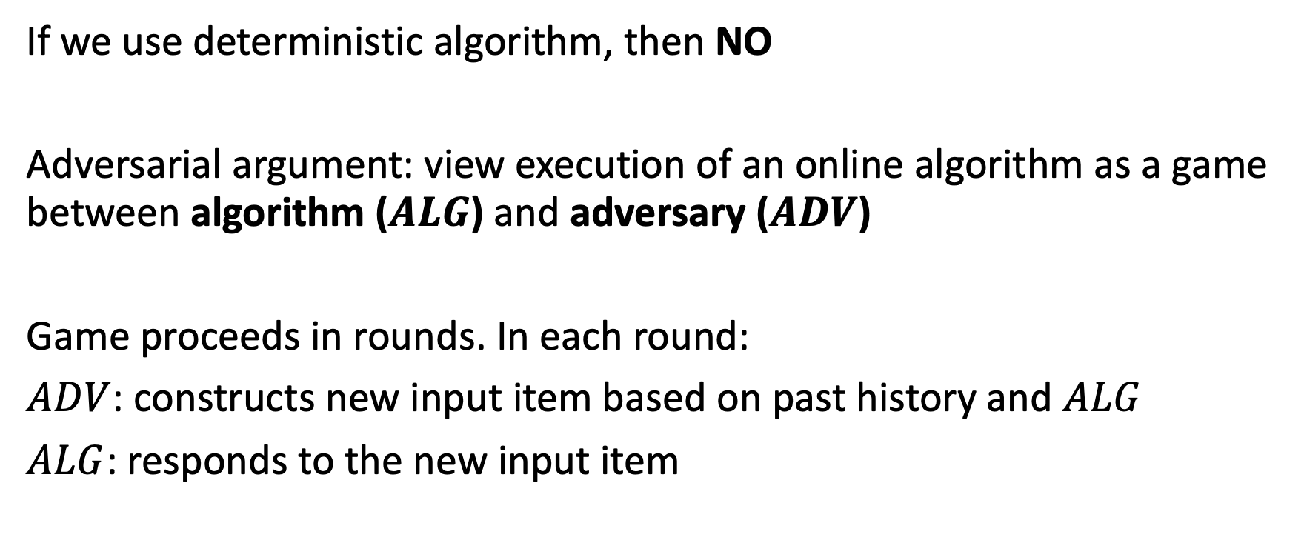
Can we do better?
If we use deterministic algorithm, then NO
Adversarial argument: view execution of an online algorithm as a game between algorithm ($ALG$) and adversary ($ADV$)
Game proceeds in rounds. In each round:
$ADV$: constructs new input item based on past history and $ALG$
$ALG$: responds to the new input item
Notes:
Adversary对手
我们利用对抗性分析，来确定一个算法能否改进，比如说上课的时候有个同学说如果我不在i=b-1的那一天买，而是i=b/2 – 1那一天买。我们用对抗性分析，构建出一个最差的结果，也就是刚买滑雪板之后那天就结束滑雪。根据计算可得，如果在i=b/2 – 1那一天买滑雪板，$ρ$是3b,比之前的2-1/b要大，
我们通过对抗性分析，可以构造一个最坏情况，测试算法是否真的改进了竞争比。

Slide 25
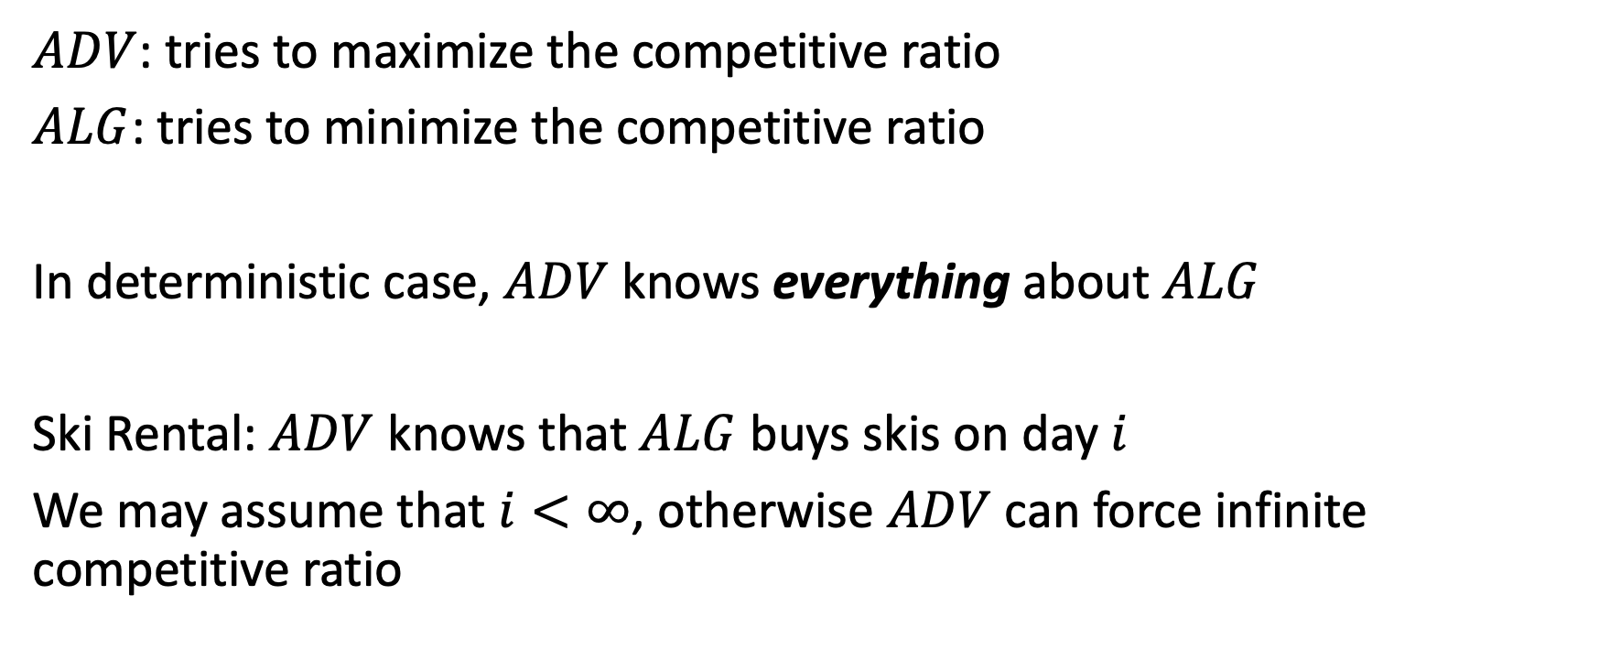
Adversary argument: ski rental
$ADV$: tries to maximize the competitive ratio
$ALG$: tries to minimize the competitive ratio
In deterministic case, $ADV$ knows everything about $ALG$
Ski Rental: $ADV$ knows that $ALG$ buys skis on day $i$
We may assume that $i<∞$, otherwise $ADV$ can force infinite competitive ratio

Slide 26
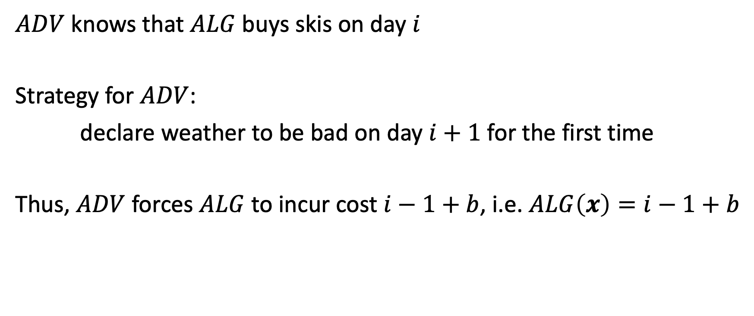
Adversary argument: ski rental
$ADV$ knows that $ALG$ buys skis on day $i$
Strategy for $ADV$:
declare weather to be bad on day $i+1$ for the first time
Thus, $ADV$ forces $ALG$ to incur cost $i−1+b$, i.e. $ALG\left(x\right)=i−1+b$

Slide 27
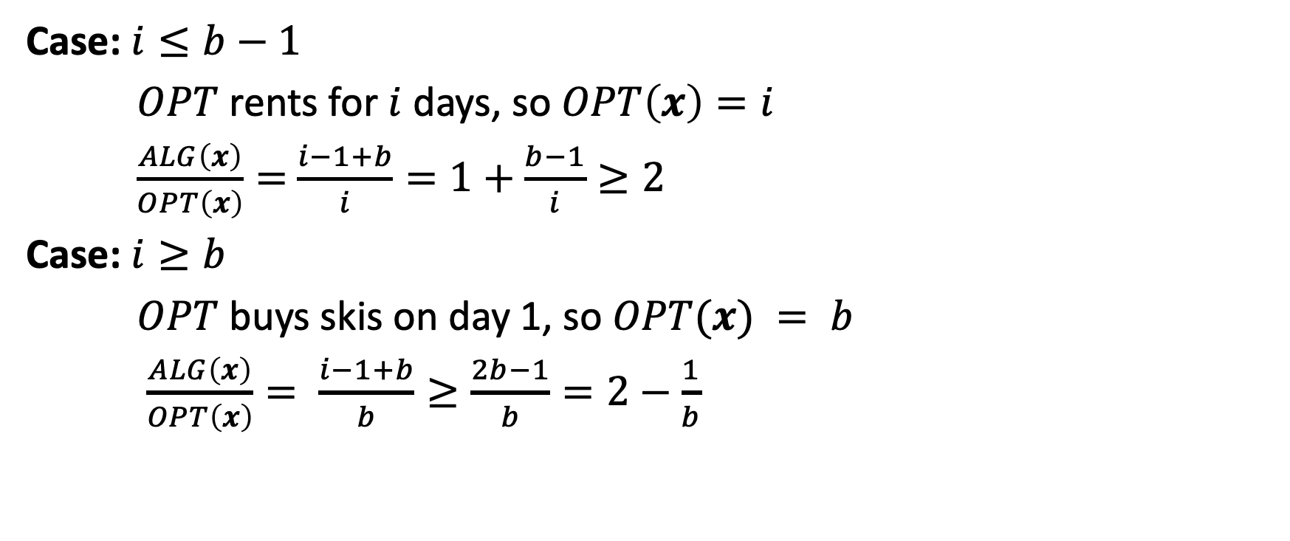
Analysis of adversary strategy
Case: $i≤b−1$
$OPT$ rents for $i$ days, so $OPT\left(x\right)=i$
$\frac{ALG\left(x\right)}{OPT\left(x\right)}=$ $\frac{i−1+b}{i}=1+\frac{b−1}{i}≥2$
Case: $i≥b$
$OPT$ buys skis on day 1, so $OPT(x) = b$
$\frac{ALG\left(x\right)}{OPT\left(x\right)}= \frac{i−1+b}{b}≥\frac{2b−1}{b}=2−\frac{1}{b}$

Slide 28
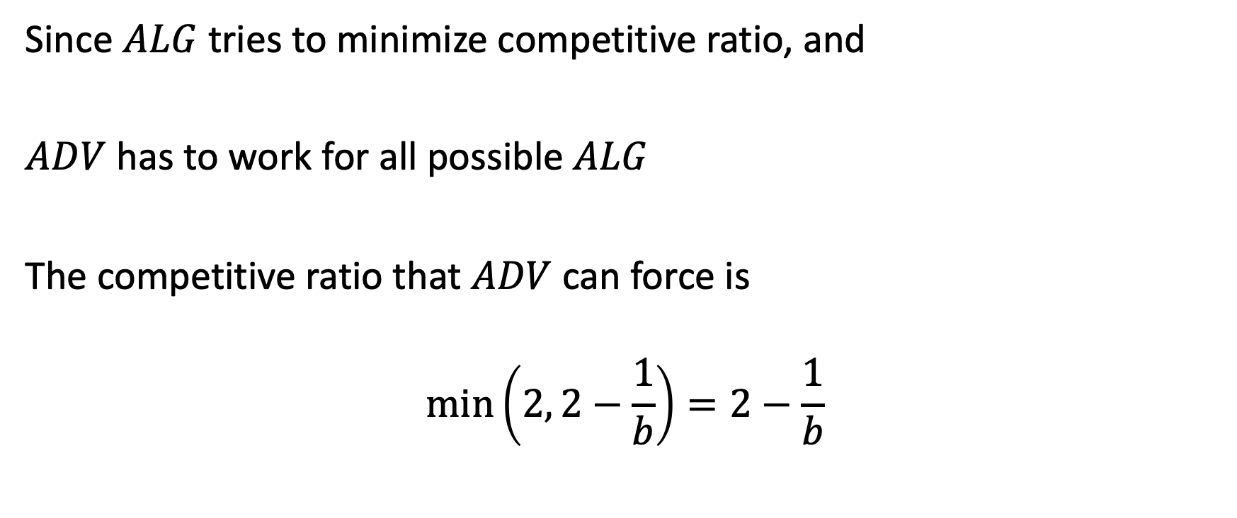
Analysis of adversary strategy
Since $ALG$ tries to minimize competitive ratio, and
$ADV$ has to work for all possible $ALG$
The competitive ratio that $ADV$ can force is
$$\text{min}\left(2, 2−\frac{1}{b}\right)=2−\frac{1}{b}$$

Slide 29
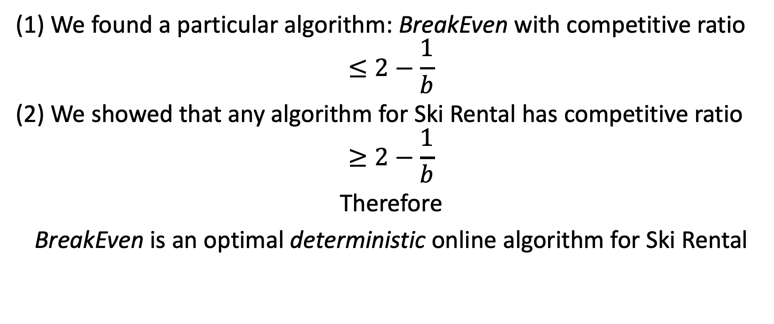
Putting it together
(1) We found a particular algorithm: BreakEven with competitive ratio
$$≤2−\frac{1}{b}$$
(2) We showed that any algorithm for Ski Rental has competitive ratio
$$≥2−\frac{1}{b}$$
Therefore
BreakEven is an optimal deterministic online algorithm for Ski Rental

Slide 30
More generally
Results of type (1), i.e., find a good algorithm, are called
Upper bounds or
Positive results
Results of type (2), i.e., prove no algorithm can do well, are called
Lower bounds or
Negative results
Upper/lower bound terminology becomes ambiguous when dealing with maximization problems, so prefer to use positive/negative
Notes:
我们能不能说一个算法的最优表现是positive result
一个问题的最好结果negative results
如果正向结果和负向结果一致，即可称为紧界 (Tight Bound)，表明算法已经达到最优解。

Slide 31
Notes on positive/negative results
When the two results coincide, we get a tight bound
Positive/negative results can refer to algorithms AND problems
 | Positive result | Negative result
Algorithm | Prove that this particular algorithm works well on all instances | Find an instance on which this particular algorithm works badly
Problem | Find some algorithm that works well on all instances of the problem | Prove that all algorithms work badly on some instance of this problem
Notes:
Coincide 重合
Tight bound紧界
如果某个算法的正向结果和某个问题的负向结果一致，那么这个算法就是最优解。

Slide 32
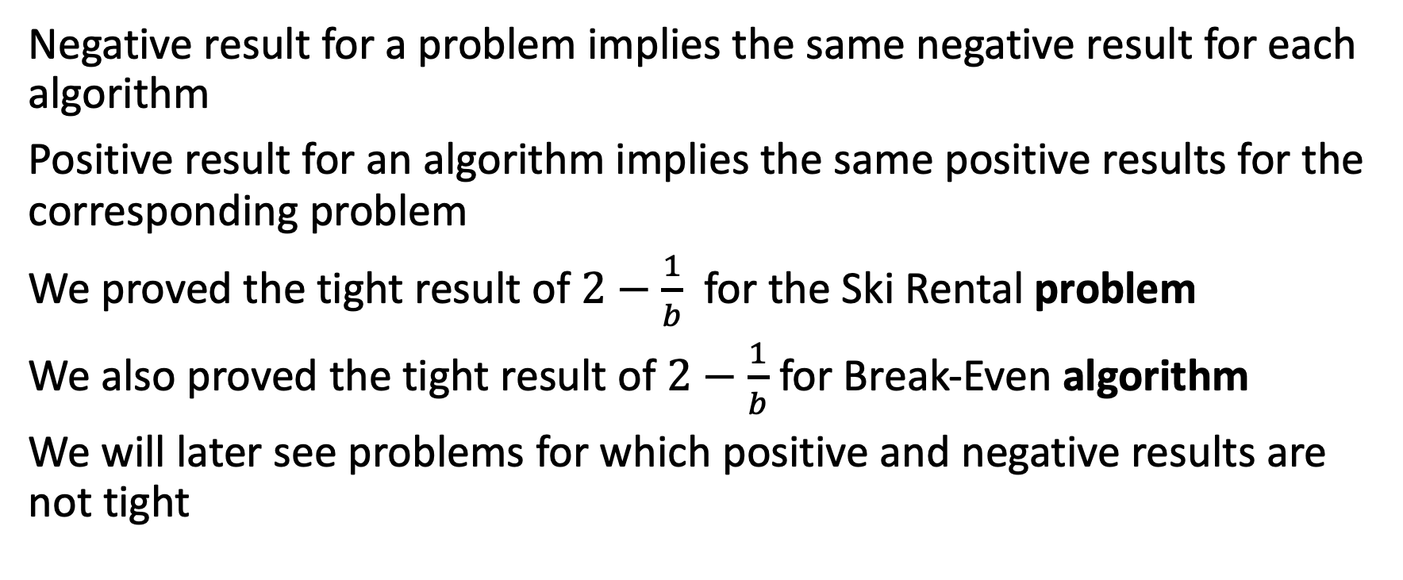
Notes on positive/negative results
Negative result for a problem implies the same negative result for each algorithm
Positive result for an algorithm implies the same positive results for the corresponding problem
We proved the tight result of $2−\frac{1}{b}$ for the Ski Rental problem
We also proved the tight result of $2−\frac{1}{b}$ for Break-Even algorithm
We will later see problems for which positive and negative results are not tight

Slide 33
Organization of the course
Deterministic online algorithms
Randomized online algorithms
Methods of analysis: potential function method
Classical online problems: k-Server problem
Online graph problems
Online satisfiability
Advice complexity
Streaming algorithms

Slide 34
Intermission
Go over the course outline!

Slide 35
Why care about online algorithms?
Sometimes irrevocable decisions are forced upon us:
scheduling – scheduling jobs at a data center
resource allocation – matching doctors to patients
packing – fulfilling warehouse orders
caching – evicting memory pages from a cache
online advertising – displaying ad banner to a user
online learning – each new data sample is processed and incorporated into a learning algorithm
big data – processing large volumes of data (streams)

Slide 36
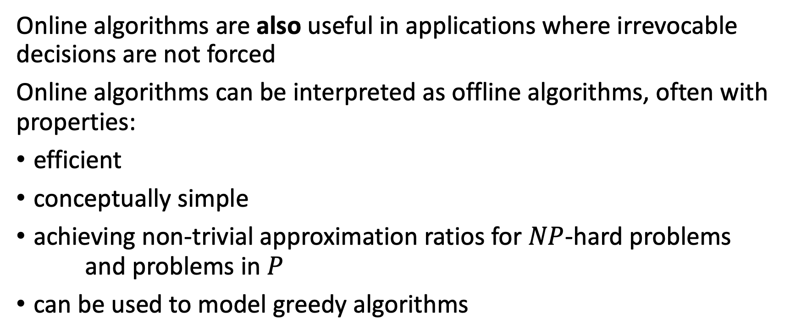
Why care about online algorithms?
Online algorithms are also useful in applications where irrevocable decisions are not forced
Online algorithms can be interpreted as offline algorithms, often with properties:
efficient
conceptually simple
achieving non-trivial approximation ratios for $NP$-hard problems and problems in $P$
can be used to model greedy algorithms

Slide 37
Typical process of studying online problems
Step 1: define the problem precisely
define input items
define decisions
define an objective
Step 2: prove a tight bound on deterministic algorithms (worst-case)
Step 3: prove a tight bound on randomized algorithms (worst-case)
Step 4: prove a tight advice-competitive ratio tradeoff (worst-case)
Step 5: redo previous steps under other models: stochastic, streaming, etc.

Slide 38
Short history of online algorithms
1966 – Ron Graham gave analysis of an online greedy alg for Makespan
1980 – Andrew Yao gave online algorithms for Bin Packing
1985 – Sleator and Tarjan analyze online algorithms for Paging
this paper argued in favor of worst-case analysis
1988 – Karlin et al. introduced the term competitive analysis
… - A lot of work on k-Server, Paging, Makespan, Online Learningetc.
1998 – El-Yaniv and Borodin book on online algorithms
2009 – Feldman et al. reintroduce amortized analysis for Bipartite Matching
2020 – A lot of new work on machine-learned advice.

Slide 39
Back to Online Algorithms

Slide 40
Back to ski rental: Can we do better than 2-1/b?
We have proved:
NO (if we use a deterministic algorithm)
Can we do better if we allow randomized decisions?
Solutions constructed by such algorithms are random variables
How should we measure performance of such algorithms?
What’s a competitive ratio for randomized algorithms?
These questions will be answered in a couple of weeks

Slide 41
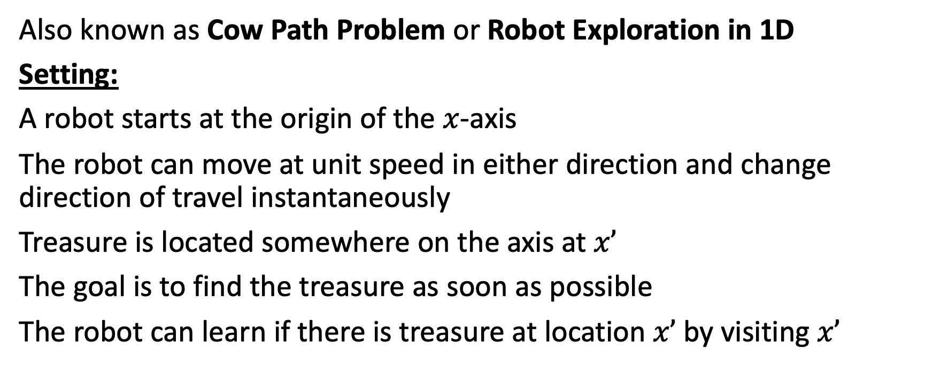
Another example: Line Search Problem
Also known as Cow Path Problem or Robot Exploration in 1D
Setting:
A robot starts at the origin of the $x$-axis
The robot can move at unit speed in either direction and change direction of travel instantaneously
Treasure is located somewhere on the axis at $x’$
The goal is to find the treasure as soon as possible
The robot can learn if there is treasure at location $x’$ by visiting $x’$

Slide 42


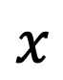
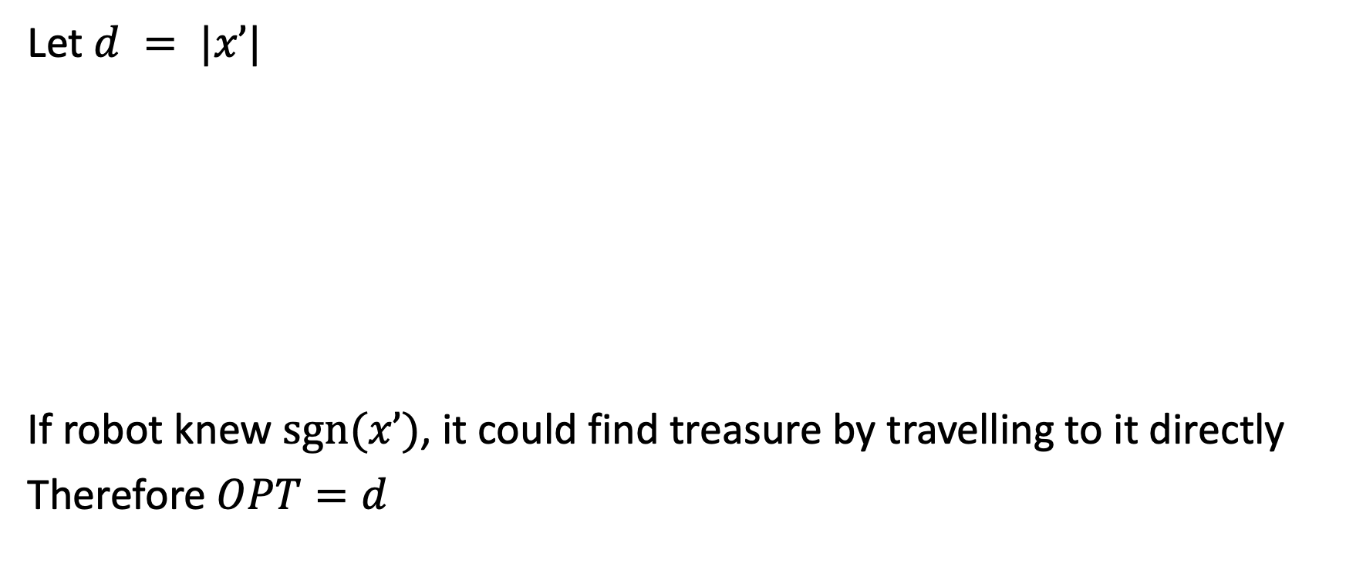

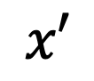
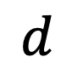
Line Search Problem
$$d$$
Let $d = |x’|$
If robot knew $sgn⁡(x’)$, it could find treasure by travelling to it directly
Therefore $OPT=d$
$$x$$
$$0$$
$$x′$$
Notes:
optimal offline algorithm

Slide 43

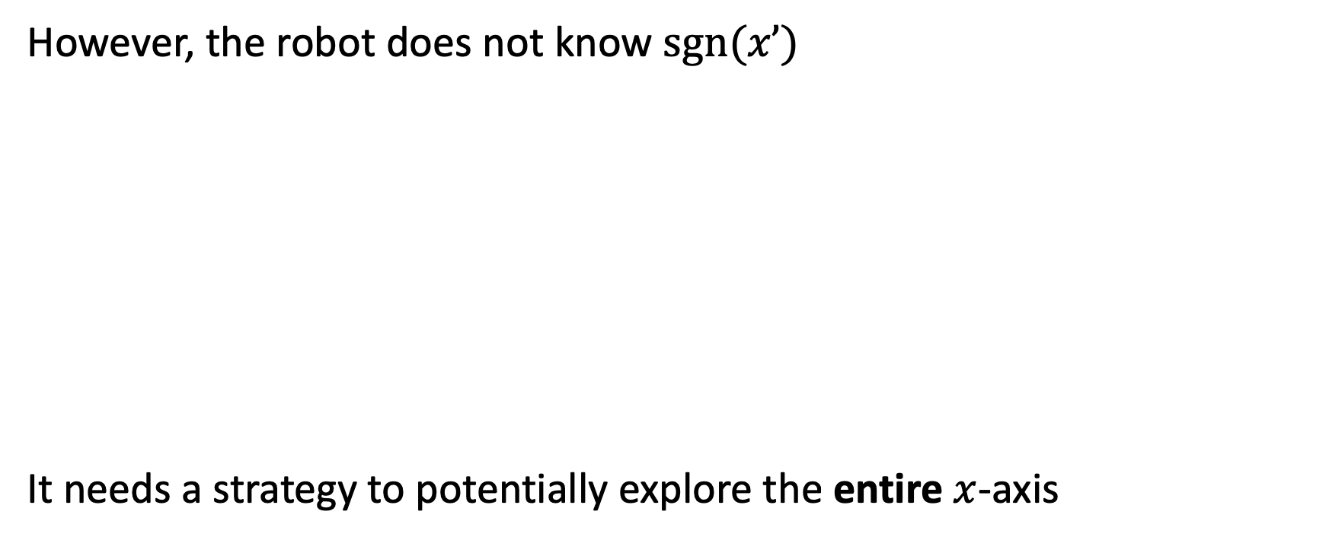
Line Search Problem
However, the robot does not know $sgn⁡(x’)$
It needs a strategy to potentially explore the entire $x$-axis
$$x$$
?

Slide 44

Line Search Problem
Natural strategy: zig-zag!
…

Slide 45
Line Search Problem
Zig-zag doubling strategy:
Pick a direction +1 and distance 1
Repeat until treasure is found:
Travel in the chosen direction for the given distance
Return to the origin
Flip the direction and double the distance
Note: if you’ve seen vector data structure implementation, then doubling strategy will look familiar

Slide 46
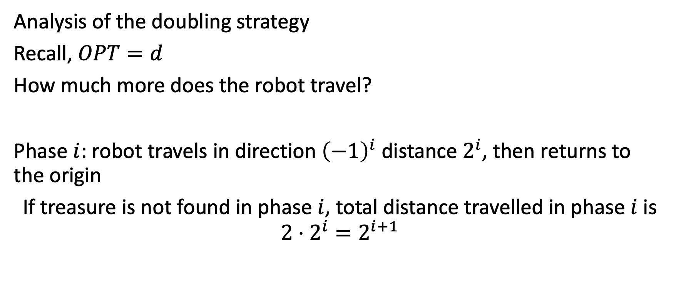
Line Search Problem
Analysis of the doubling strategy
Recall, $OPT=d$
How much more does the robot travel?
Phase $i$: robot travels in direction ${\left(−1\right)}^{i}$ distance $2^{i}$, then returns to the origin
If treasure is not found in phase $i$, total distance travelled in phase $i$ is $2⋅2^{i}=2^{i+1}$
Notes:
i从0开始

Slide 47
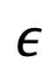
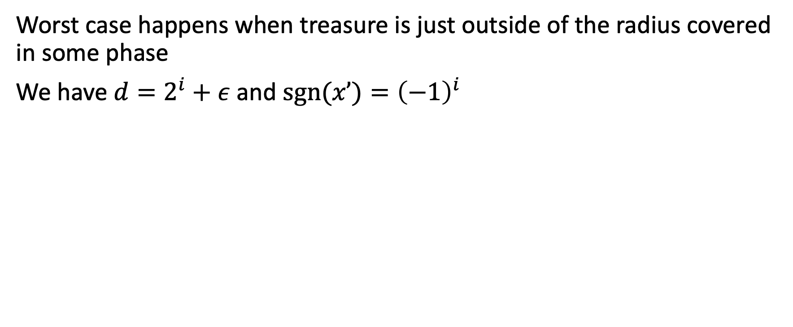
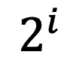

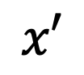
Line Search Problem
Worst case happens when treasure is just outside of the radius covered in some phase
We have $d=2^{i}+ε$ and $sgn⁡(x’)={\left(−1\right)}^{i}$
$$ε$$
$$d$$
$$x$$
$$0$$
$$2^{i}$$
$$x′$$

Slide 48
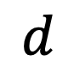
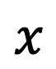
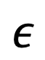
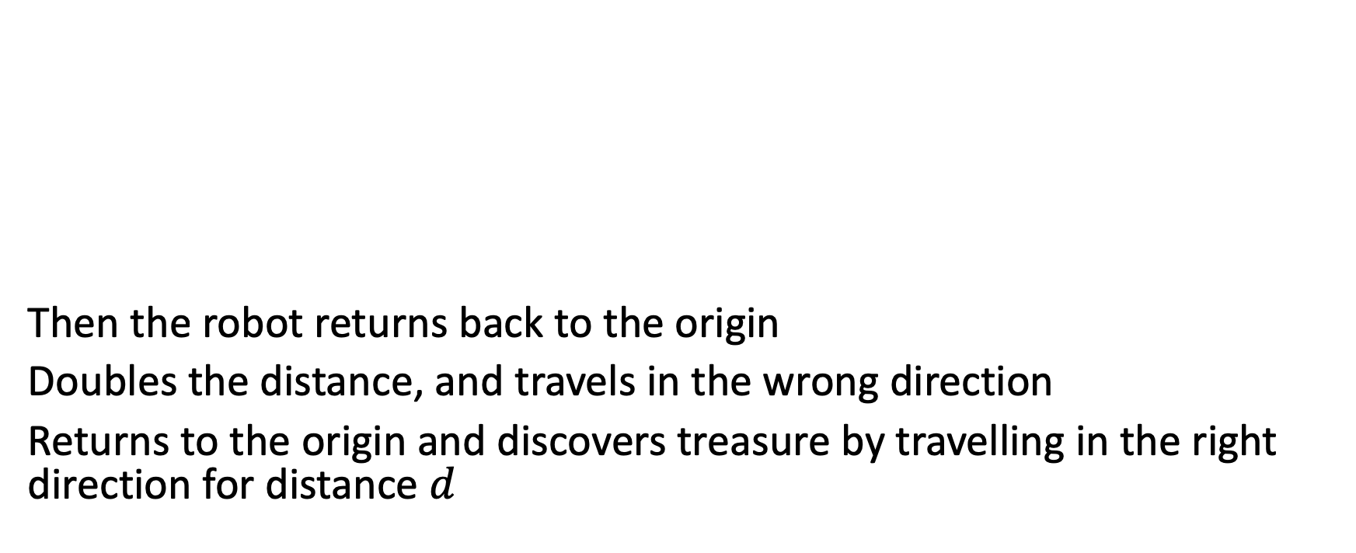
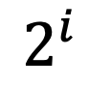

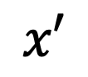
Line Search Problem
$$ε$$
$$d$$
Then the robot returns back to the origin
Doubles the distance, and travels in the wrong direction
Returns to the origin and discovers treasure by travelling in the right direction for distance $d$
$$x$$
$$0$$
$$2^{i}$$
$$x′$$

Slide 49
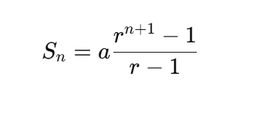
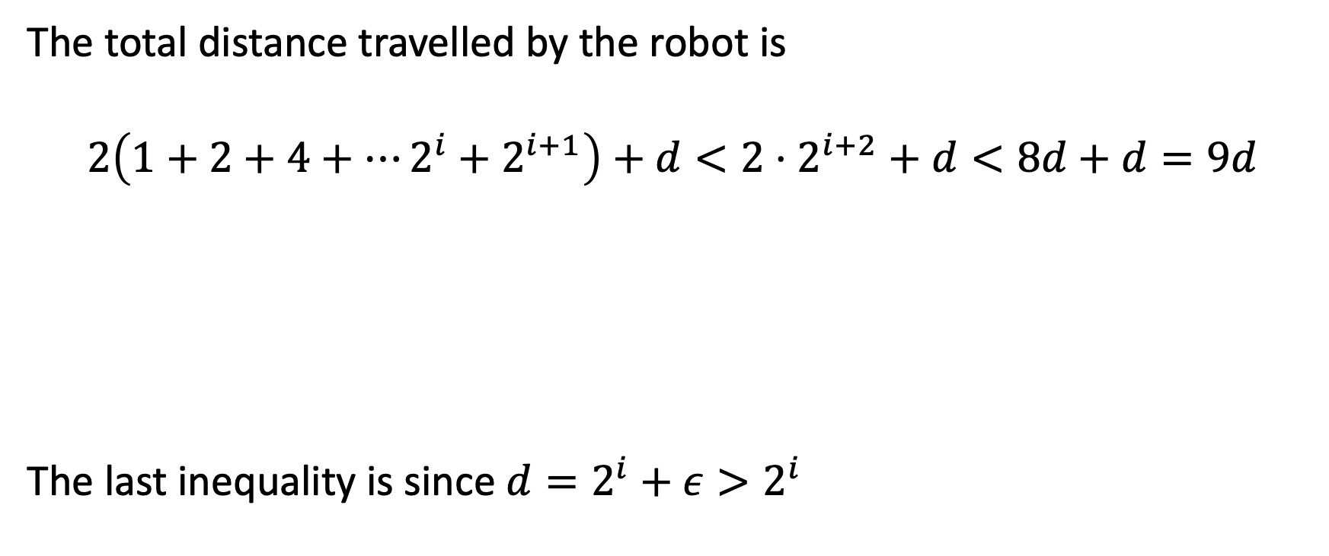
Line Search Problem
The total distance travelled by the robot is
$$2\left(1+2+4+⋯2^{i}+2^{i+1}\right)+d<2⋅2^{i+2}+d<8d+d=9d$$
The last inequality is since $d=2^{i}+ε>2^{i}$
all work until
barely missing treasure
wrong
direction
one last time
Finding
treasure
Notes:
等比数列求和： 首项：1 公比r：2 项数：i+2

Slide 50
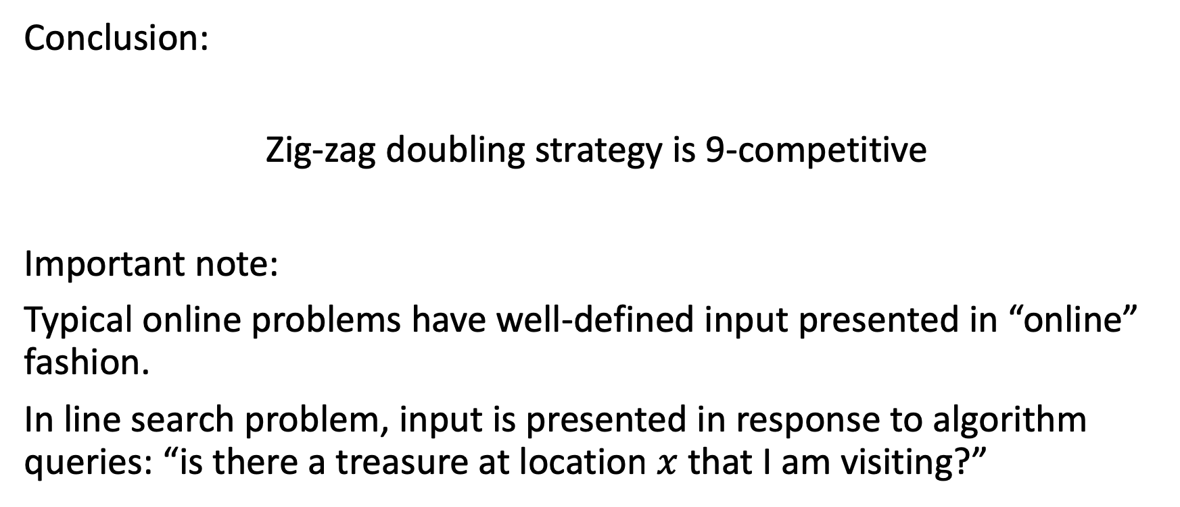
Line Search Problem
Conclusion:
Zig-zag doubling strategy is 9-competitive
Important note:
Typical online problems have well-defined input presented in “online” fashion.
In line search problem, input is presented in response to algorithm queries: “is there a treasure at location $x$ that I am visiting?”
Notes:
这个问题的输入不是主动给出的，而是由算法的每次查询触发，但他仍然是一个在线问题

Slide 51
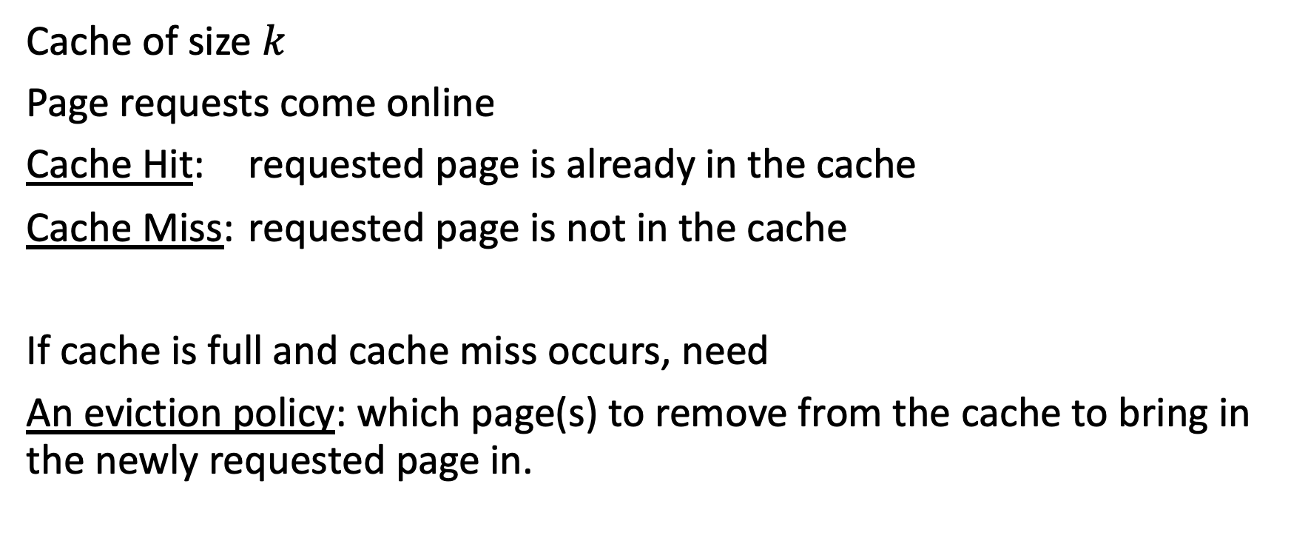
Another example: paging
Cache of size $k$
Page requests come online
Cache Hit: requested page is already in the cache
Cache Miss: requested page is not in the cache
If cache is full and cache miss occurs, need
An eviction policy: which page(s) to remove from the cache to bring in the newly requested page in.

Slide 52
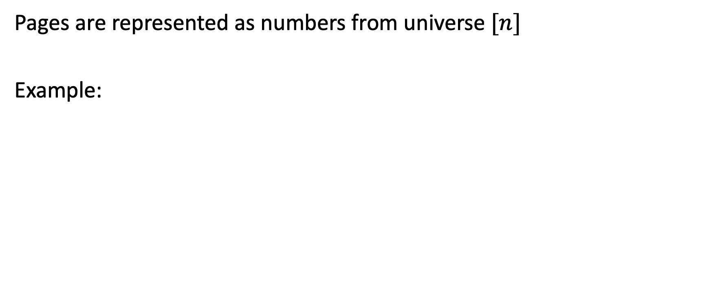
Paging
Pages are represented as numbers from universe $[n]$
Example:
Cache contents:
Request sequence:
5
3
4
3
1
5
3
4

Slide 53
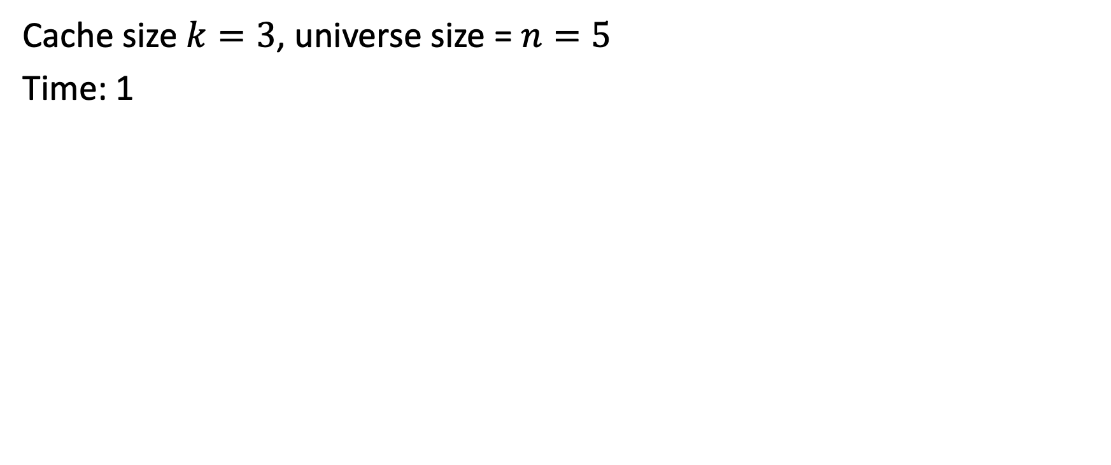
Paging Example
Cache size $k=3$, universe size = $n=5$
Time: 1
Cache contents:
Cache MISS!
5
3
4
3
1
5
3
4
5

Slide 54
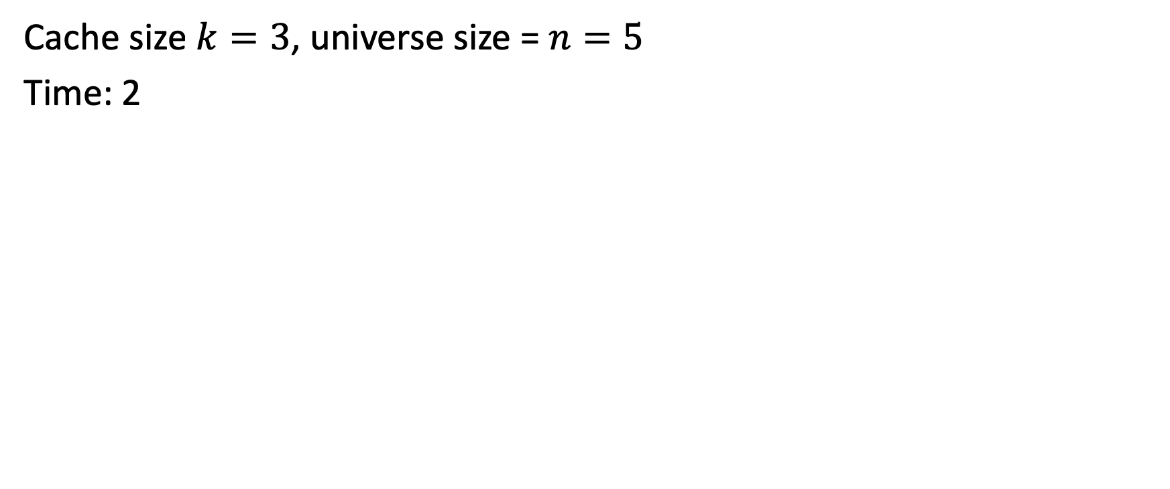
Paging Example
Cache size $k=3$, universe size = $n=5$
Time: 2
Cache contents:
Cache MISS!
3
5
3
4
3
1
5
3
4
5

Slide 55
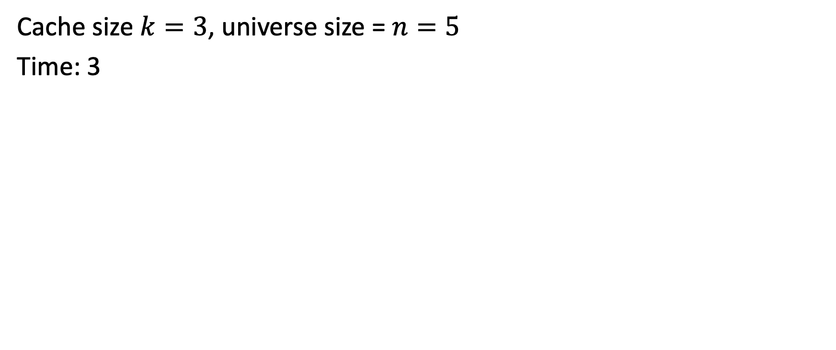
Paging Example
Cache size $k=3$, universe size = $n=5$
Time: 3
Cache contents:
Cache MISS!
4
3
5
3
4
3
1
5
3
4
5

Slide 56

Paging Example
Cache size $k=3$, universe size = $n=5$
Time: 3
Cache contents:
Cache HIT!
4
3
5
3
4
3
1
5
3
4
5

Slide 57


Paging Example
Cache size $k=3$, universe size = $n=5$
Time: 3
Cache contents:
Cache MISS!
4
3
5
3
4
3
1
5
3
4
5
1

Slide 58
Paging Example
Cache size $k=3$, universe size = $n=5$
Time: 3
Cache contents:
Cache MISS!
4
3
5
5
3
4
3
1
5
3
4
1

Slide 59
Paging Example
Cache size $k=3$, universe size = $n=5$
Time: 3
Cache contents:
Cache MISS!
4
3
5
5
3
4
3
1
5
3
4
1

Slide 60
Paging Example
Cache size $k=3$, universe size = $n=5$
Time: 3
Cache contents:
Cache MISS!
3
5
5
3
4
3
1
5
3
4
1
4

Slide 61
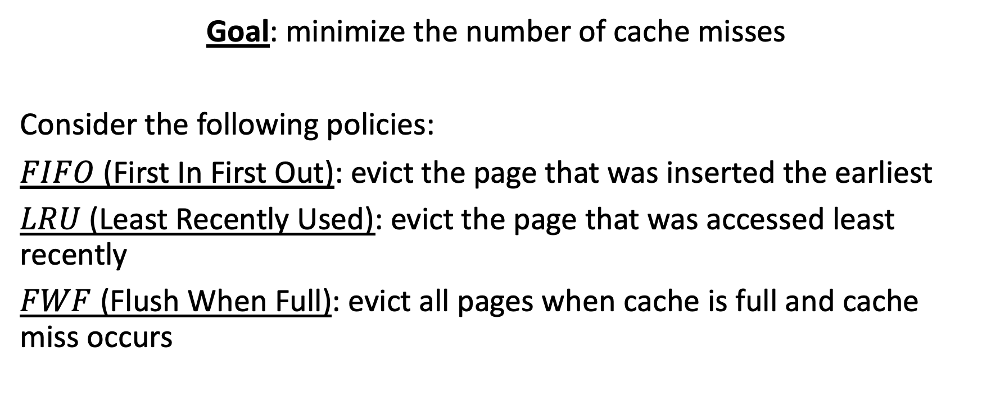
Paging
Goal: minimize the number of cache misses
Consider the following policies:
$FIFO$ (First In First Out): evict the page that was inserted the earliest
$LRU$ (Least Recently Used): evict the page that was accessed least recently
$FWF$ (Flush When Full): evict all pages when cache is full and cache miss occurs

Slide 62
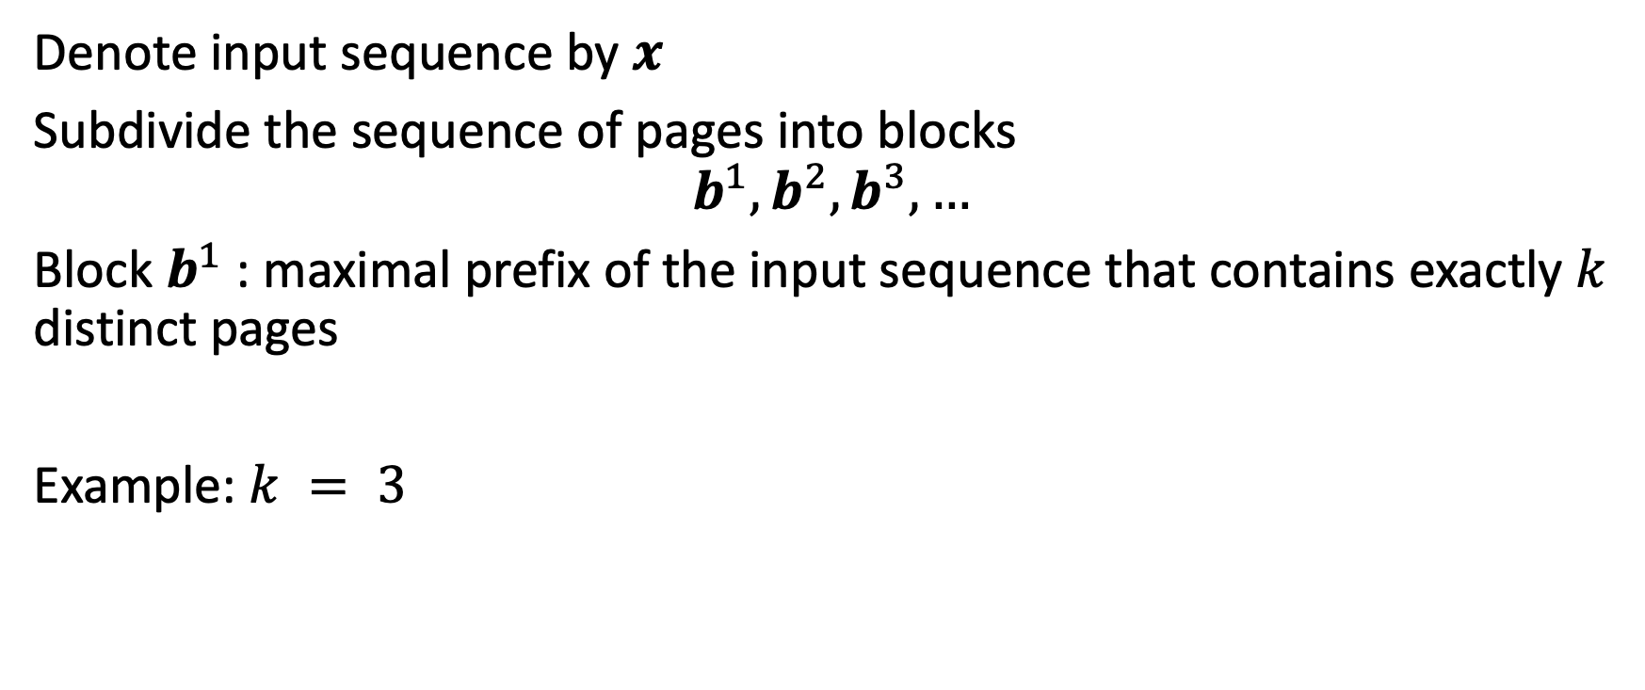


$FIFO$ analysis, positive result
Denote input sequence by $x$
Subdivide the sequence of pages into blocks
$$b^{1},b^{2},b^{3},…$$
Block $b^{1}$ : maximal prefix of the input sequence that contains exactly $k$ distinct pages
Example: $k = 3$
5
3
4
3
1
5
3
4
$$b^{1}$$

Slide 63

$FIFO$ analysis, positive result
Input sequence $x$ subdivided into $s$ blocks: $b^{1},b^{2},b^{3},…, b^{s}$
$b^{1}$: maximal prefix of $x$ with exactly $k$ distinct pages
$b^{2}$: maximal prefix of $x−b^{1}$ with exactly $k$ distinct pages
$b^{3}$: maximal prefix of $x−b^{1}−b^{2}$ with exactly $k$ distinct pages
$⋮$
$FIFO$ incurs at most $k$ cache misses per block (why?). Therefore:
$$FIFO\left(x\right)≤sk$$

Slide 64






$FIFO$ analysis, positive result
Define the $i$^{th} shifted block ${\hat{b}}^{i}$ to consist of all pages of block $b^{i}$ except for the first page plus the first page of block $b^{i+1}$:
$$b^{i}$$
$$b^{i+1}$$
1
5
3
4
3
1
5
3
4
$$⋯$$
$$⋯$$
$${\hat{b}}^{i}$$

Slide 65

$FIFO$ analysis, positive result
Shifted blocks partition the entire sequence $x$ except for the first item
$OPT$ incurs at least one page fault per each shifted block
before ${\hat{b}}^{i}$ is processed, $OPT$ has $b_{1}^{i}$ in the cache (why?)
${\hat{b}}^{i}$ contains $k$ distinct pages all different from $b_{1}^{i}$ (why?)
Thus:
$$OPT\left(x\right)≥s−1+k$$

Slide 66

$FIFO$ analysis, positive result
Thus, assuming $s$ is large enough (at least 2) we have:
$$\frac{ALG\left(x\right)}{OPT\left(x\right)}≤\frac{sk}{s−1+k}≤k$$
Note: $k≥1$ so the denominator above is at least $s$.

Slide 67


$FIFO$ analysis, negative result
Is our analysis of $FIFO$ tight?
We will show more generally that no deterministic policy can achieve competitive ratio better than $k$
Fix deterministic policy $ALG$. Take universe size $n=k+1$
Adversary: initially, request $k$ distinct pages.
each time after that, request a page not in the cache of $ALG$ (such a page exists, because universe size is $k+1$ and cache size is $k$)
Thus, adversary can always make $ALG$ have at least $|x|$ cache misses

Slide 68


$FIFO$ analysis, negative result
Need: for $n = k+1$and any $x$, $OPT$ $≤\frac{\left|x\right|}{k}+k−1$ cache misses
First $k$ distinct pages incur $k$ cache misses
After that, when a new page arrives $OPT$ evicts a page from the cache that will be accessed furthest in the future ($OPT$ knows the entire $x$)
3
Cache
contents
Furthest in the future
Cache MISS!
2
1
2
3
4
3
1
2
3
1

Slide 69



$FIFO$ analysis, negative result
Furthest in the future:
Evicted element has to occur at least $k−1$ page requests later (why?)
Thus, $OPT$ can guarantee at most one page miss per $k$ requests
Overall, we have
$$OPT≤k+\frac{\left|x\right|−k}{k}=\frac{\left|x\right|}{k}+k−1$$
Initial $k$
pages
Remaining
$|x|−k$ pages
incur one miss
per $k$ pages

Slide 70

$FIFO$ analysis, negative result
Putting it together:
$\frac{ALG(x)}{OPT(x)}≥\frac{\left|x\right|}{\frac{\left|x\right|}{k}+k−1}=\frac{k}{1+\frac{k−1}{\left|x\right|}}→k$ as $\left|x\right|→∞$

Slide 71


$LRU$ vs. $FIFO$ vs. $FWF$
The same analysis applies to $LRU$
Competitive ratio of $FIFO$ = competitive ratio of $LRU$ $≈k$
What about $FWF$?

Slide 72

Paging: comments
The closer competitive ratio is to 1, the better (closer to $OPT$)
$LRU$ and $FIFO$ have competitive ratio $≈$ $k$ = cache size
Therefore, increasing cache size leads to a worse algorithm! (in theory)
Counterintuitive! Does not match practice
Moreover, competitive ratio does not distinguish between $LRU$ vs. $FIFO$
However, $FIFO$ is terrible in practice, and $LRU$ is excellent!
These shortcomings indicate that competitive ratio does not always match practice

Slide 73
Competitive ratio
To address these criticisms, we could consider other input/algorithmic models
Model “realistic inputs” (parameterized inputs, stochastic inputs, restricted inputs) and allow more power to algorithms (look ahead, advice, etc.)
E.g.: realistic inputs for Paging exhibit locality of reference.

